Slide 1


Facility Talk
Neutron Scattering Facilities & Mantid
Notes:
The abstract pattern can be removed or repositioned if required. Be careful to ‘Send to Back’ so that it does not obscure any important information.

Slide 2
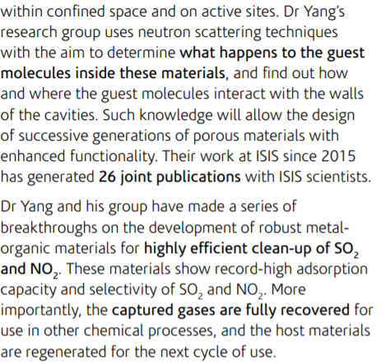
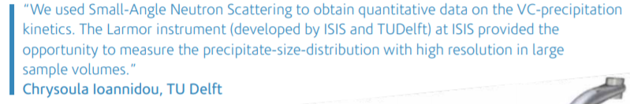
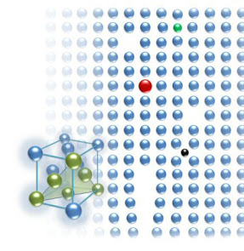
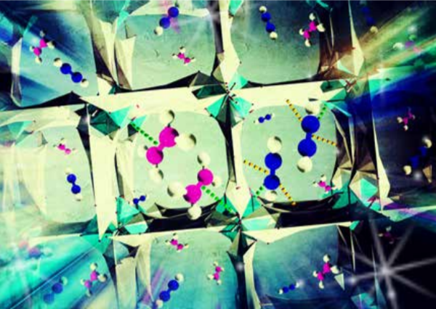
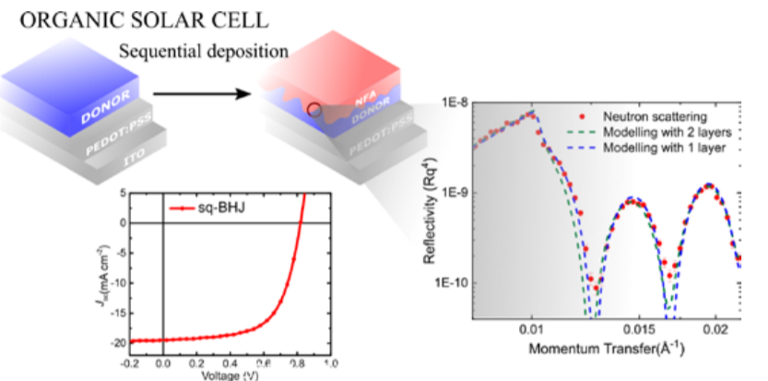
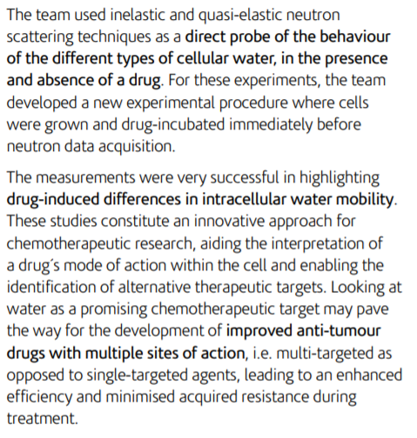
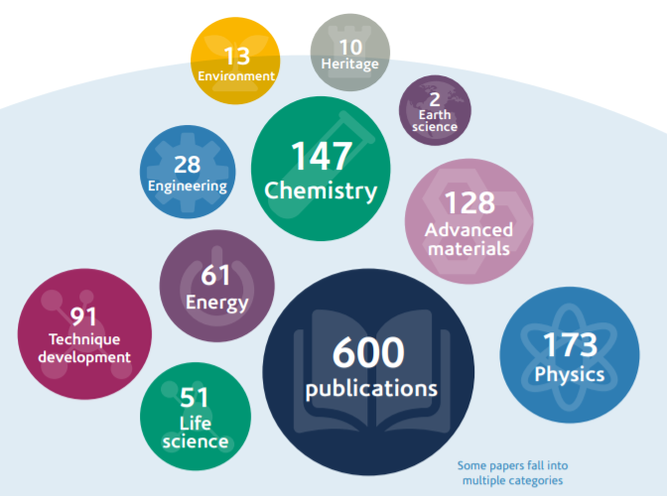

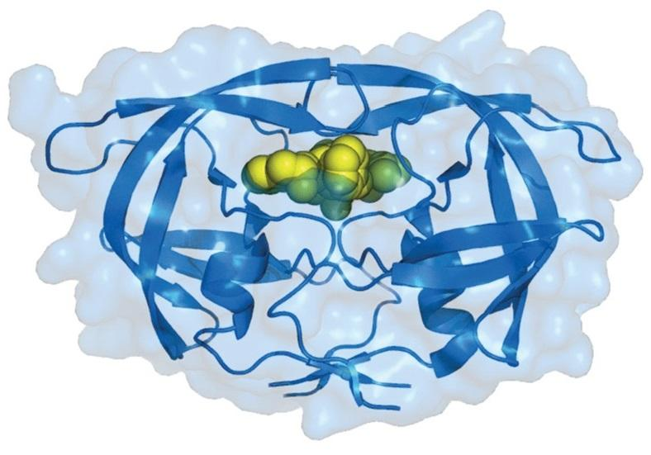
“Nano” steel
Gas Capture
Organic Solar Cells
High Tc superconductors
Drug design
https://www.isis.stfc.ac.uk/SiteAssets/Pages/ISIS-Annual-Review-2019-Out-Now/ISIS_Annual_review_Web_2019.pdf
Notes:
Catalysis
Spintronics
Magnetic devices
Micellses/surfactant a

Slide 3
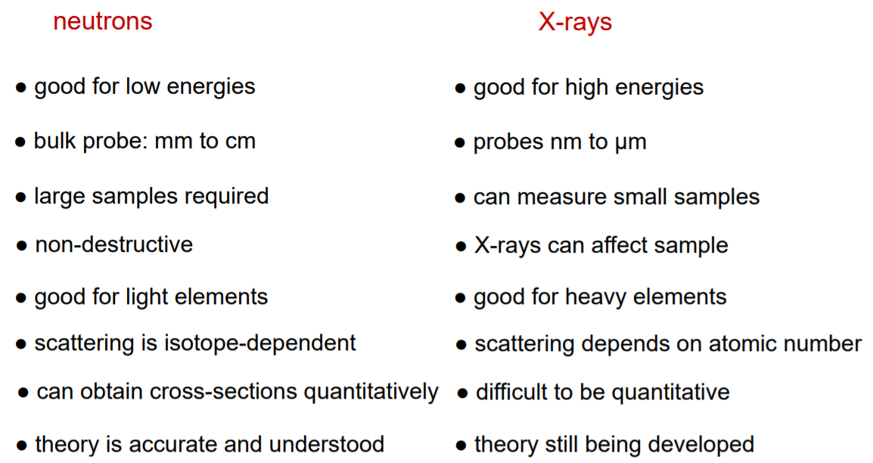
Why use neutrons (over x-rays)?

Slide 4
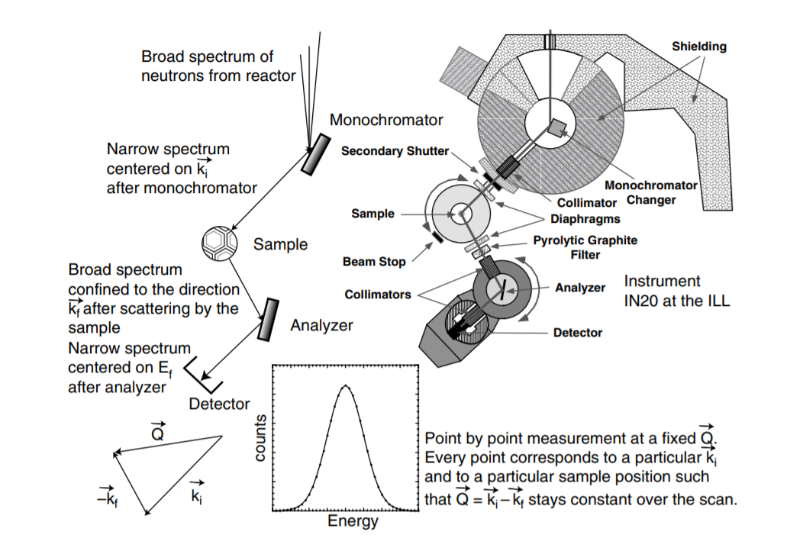
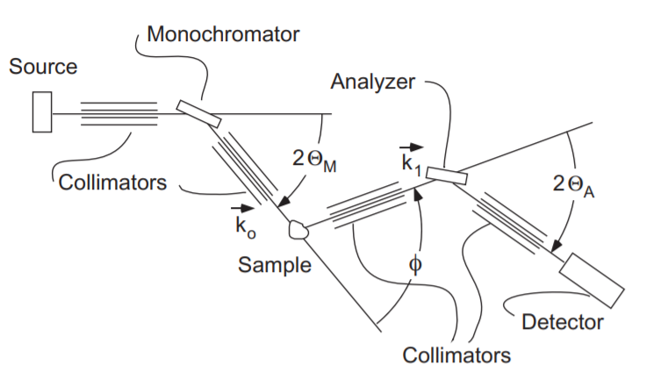
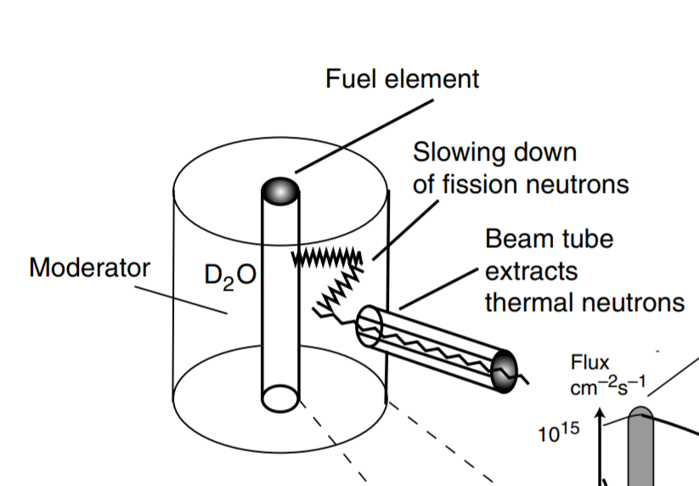
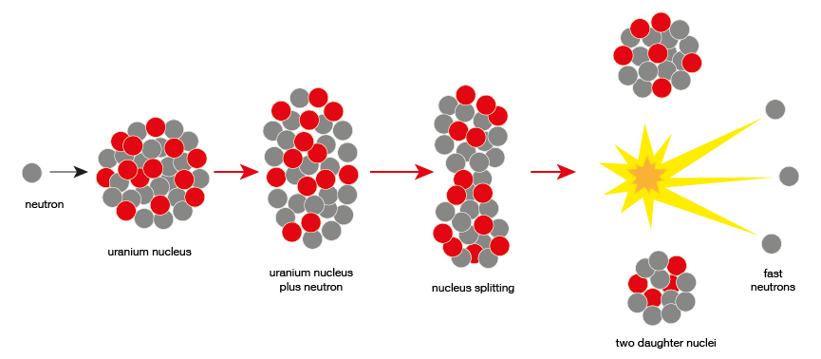
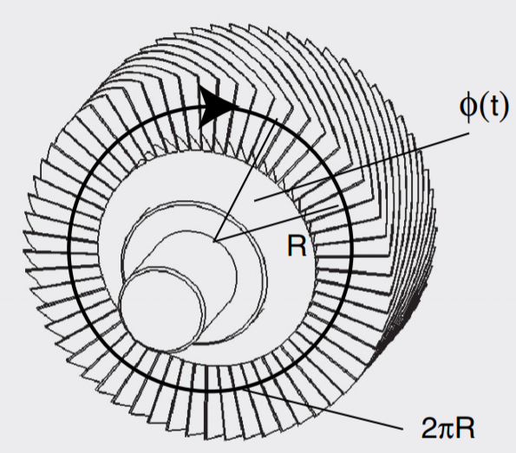
Types of neutron source
Two types of neutron source
Nuclear fission reactors (Continuous)
Nuclear Fission of ²³⁵U
2.35 neutrons/fission
`Hot’ neutrons with 50-100MeV
Use a moderator to reduce neutron energy
http://www.mlz-garching.de/englisch/neutron-research/neutron-source.html

Slide 5
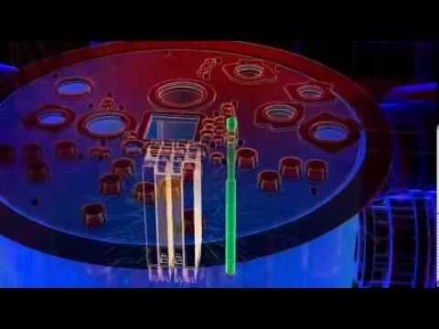
Reactor Sources

Slide 6
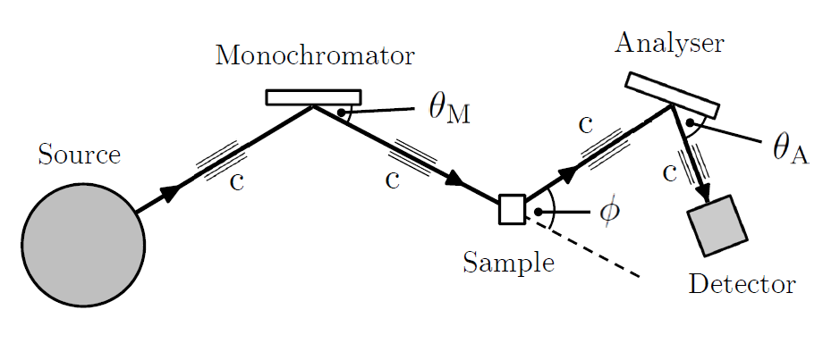
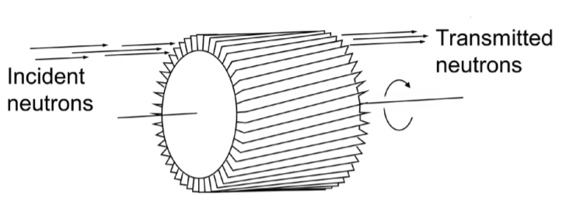
Types of neutron source
Nuclear reactors
Velocity selector reduces higher order contamination

Slide 7
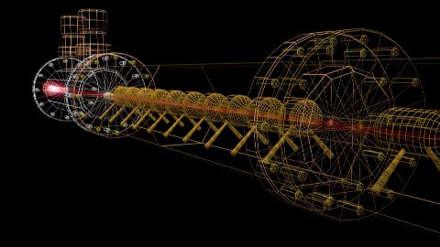
Spallation Sources

Slide 8
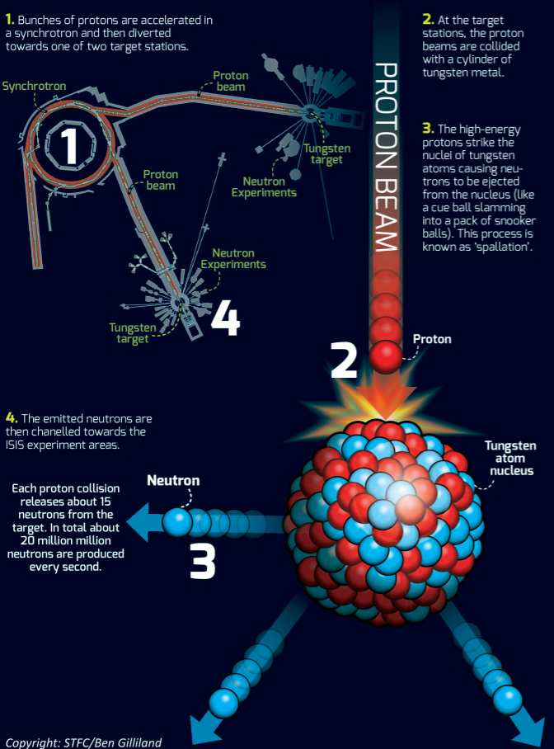
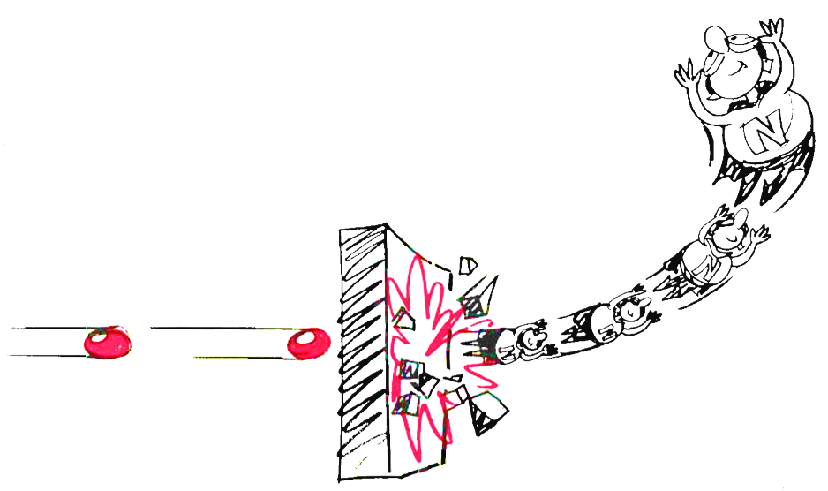
Types of neutron source
Spallation
https://stfc.ukri.org/research/our-science-facilities/isis-neutron-and-muon-source/

Slide 9
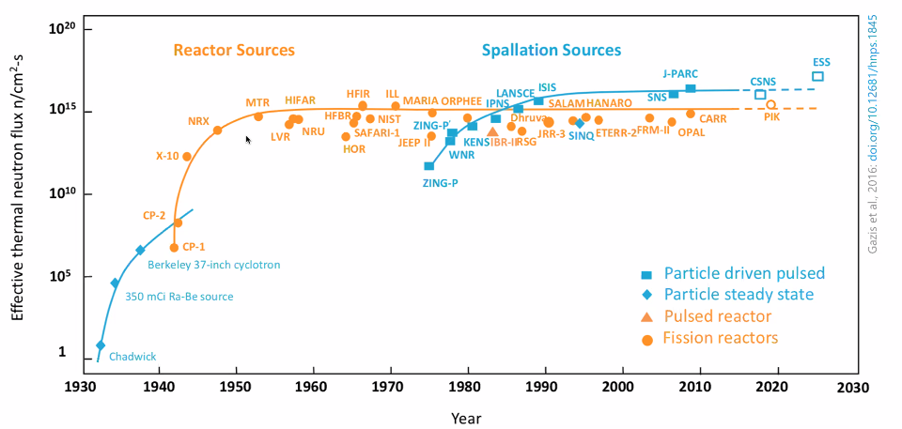
Neutron sources

Slide 10
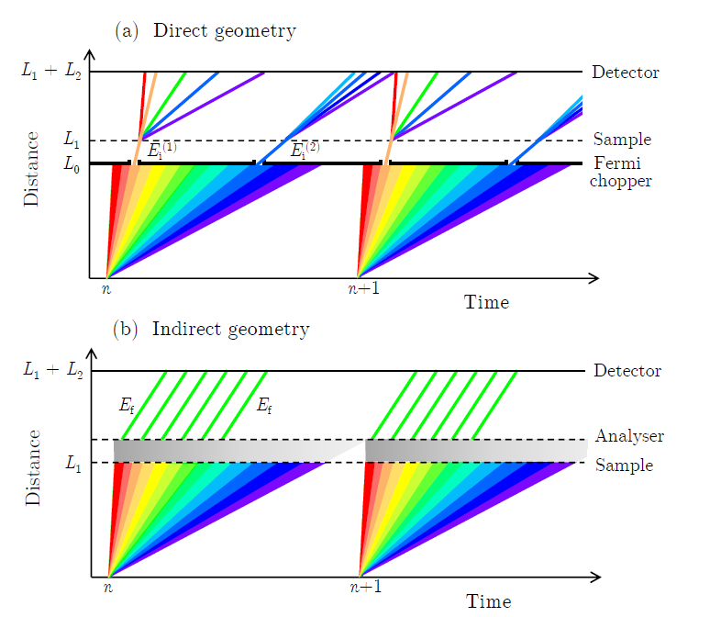
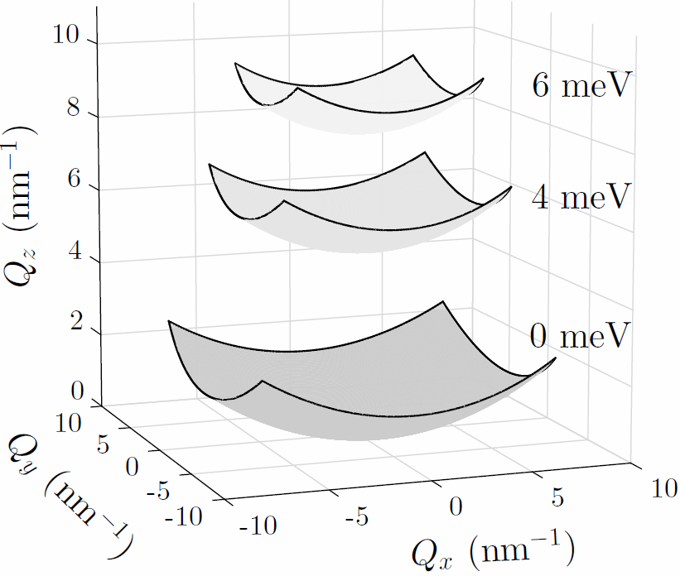
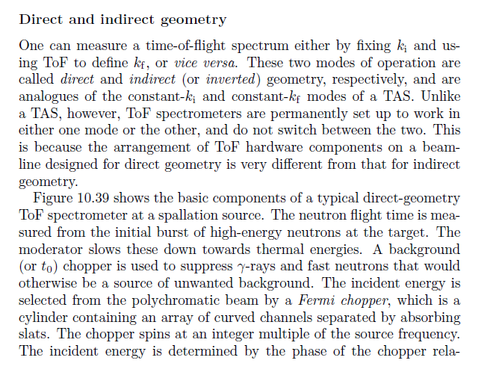
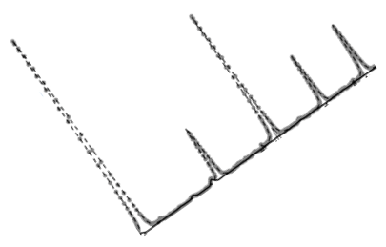
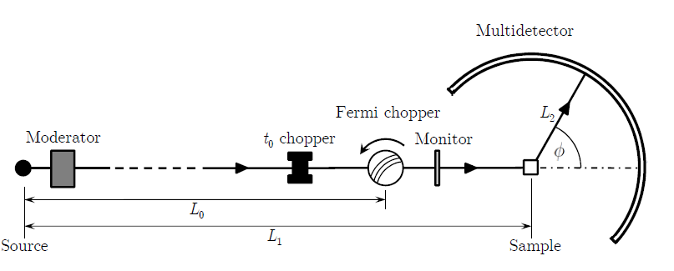
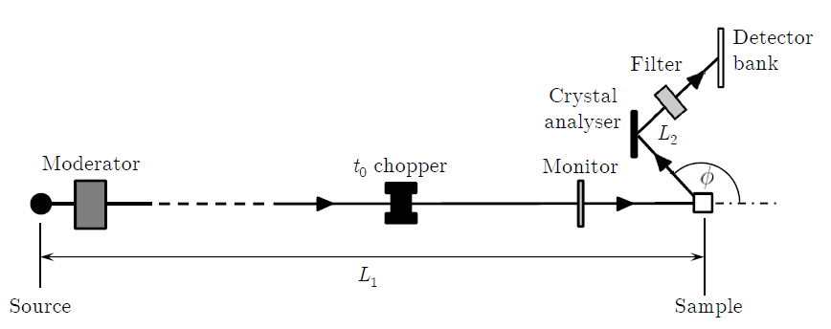
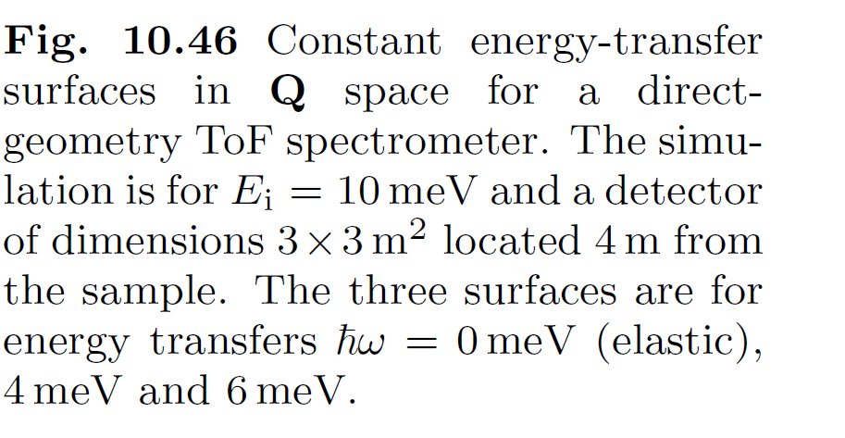
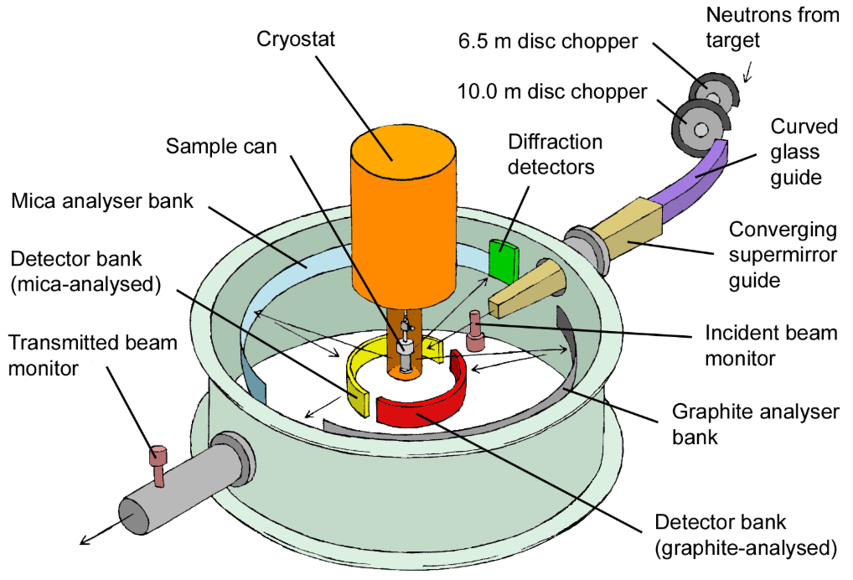
Direct geometry (DG)
Time-of-flight instruments
White-beam
Diffractometer
Direct geometry (DG) Fix k_{i}
Indirect geometry (IG) Fix k_{f}
hω < 0
hω>0
Detector
hω>0
hω < 0
Detector
Detector
Sample
Analyser
Distance
Sample
Distance
Chopper
Distance
Sample
Moderator/source
Time
Time
Time
Notes:
deltaE/E reolution depends on total flight path for indirect (rather than secondary for direct)

Slide 11
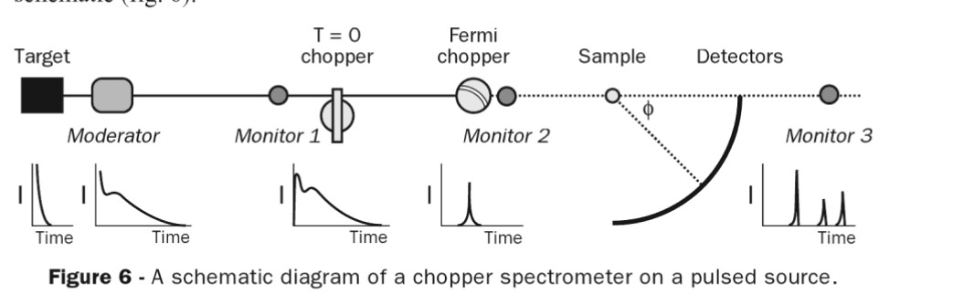
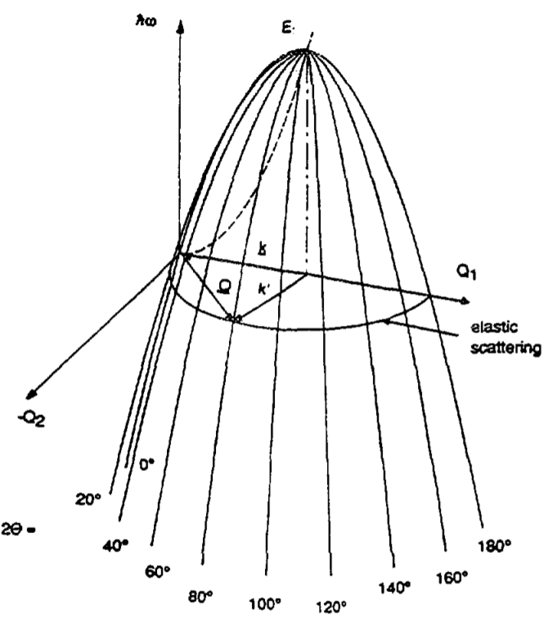
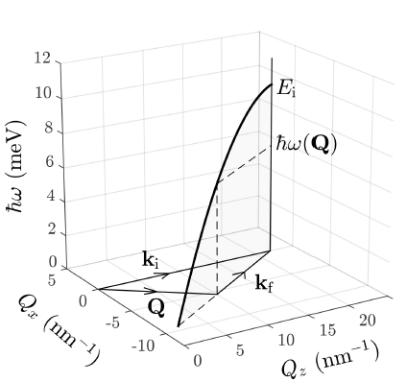
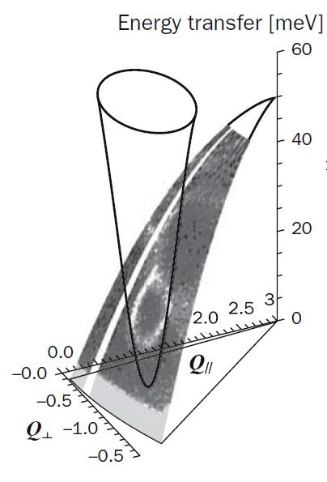
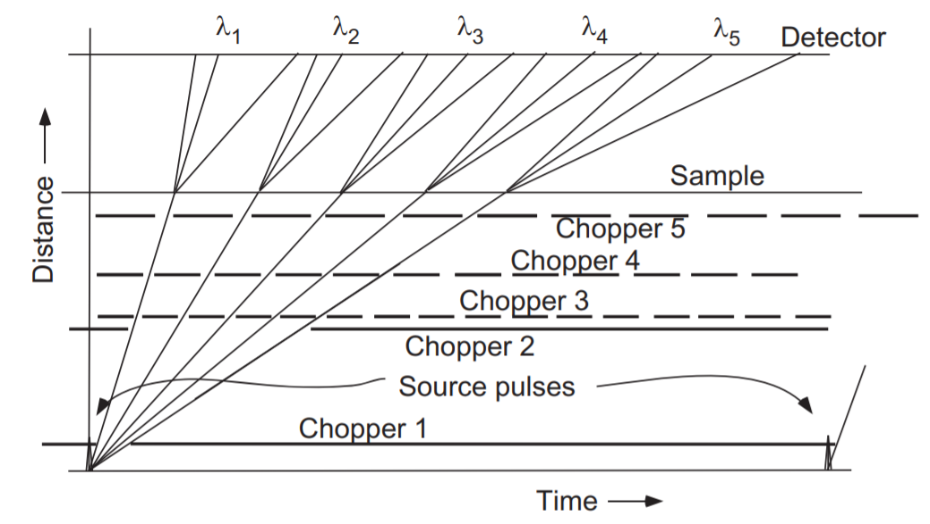
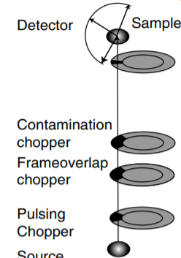
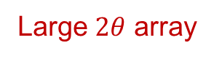
Direct geometry (DG)
Case Study: Direct TOF spectrometer
Single detector pixel
(Q,E)
Large $2θ$ array
Remember, it’s all about conservation of energy and momentum!
Excitation
e.g. spin-wave

Slide 12
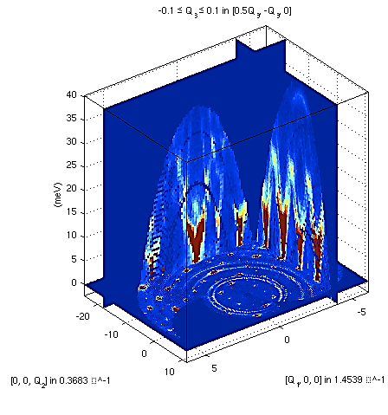
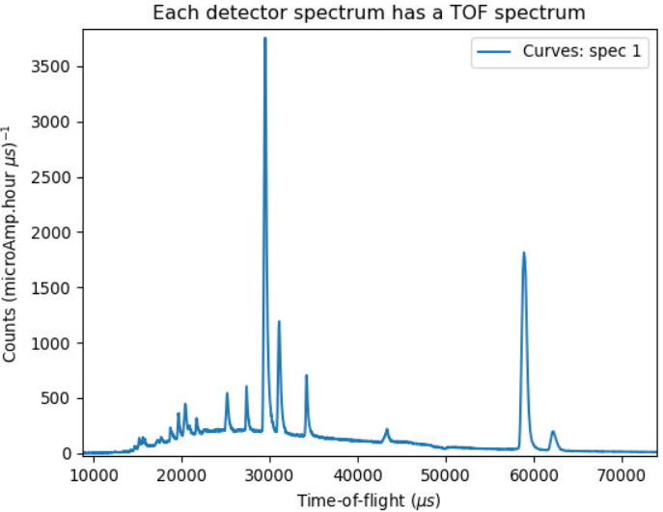
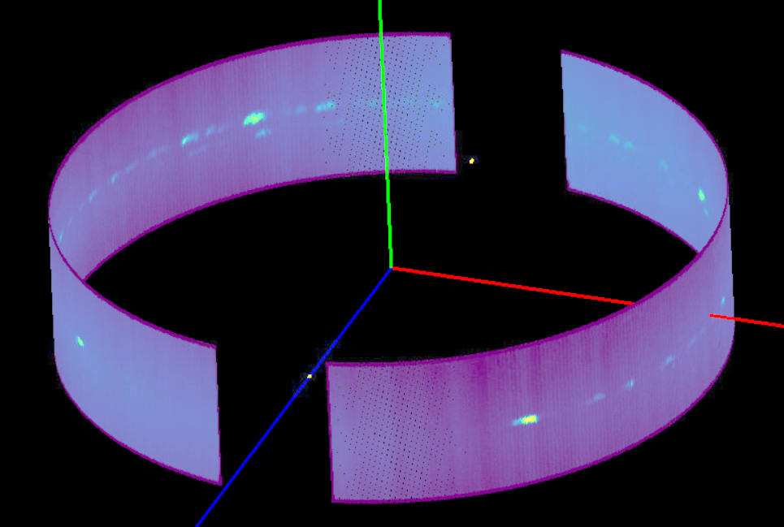
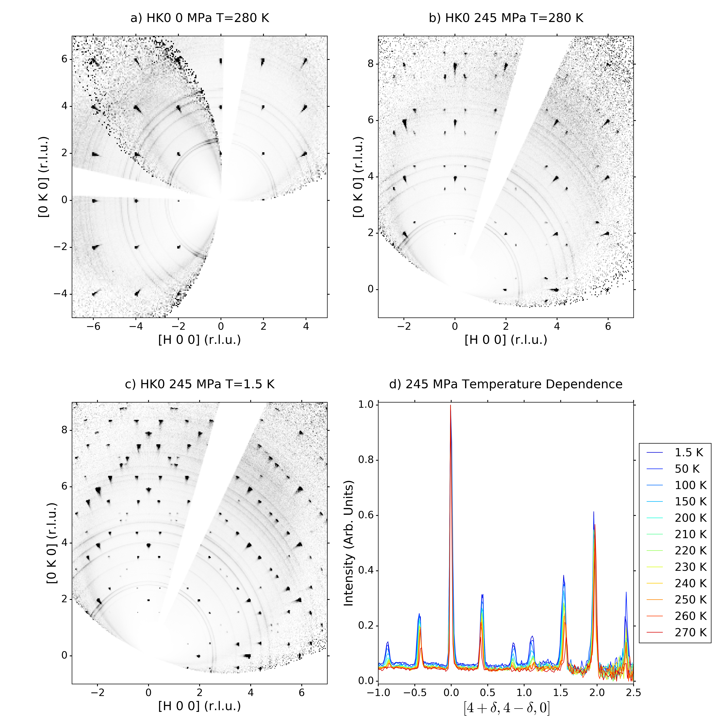
The data
Petit, Sylvain, et al. "Spin dynamics in highly frustrated pyrochlore magnets." EPJ Web of Conferences. Vol. 83. EDP Sciences, 2015.

Slide 13
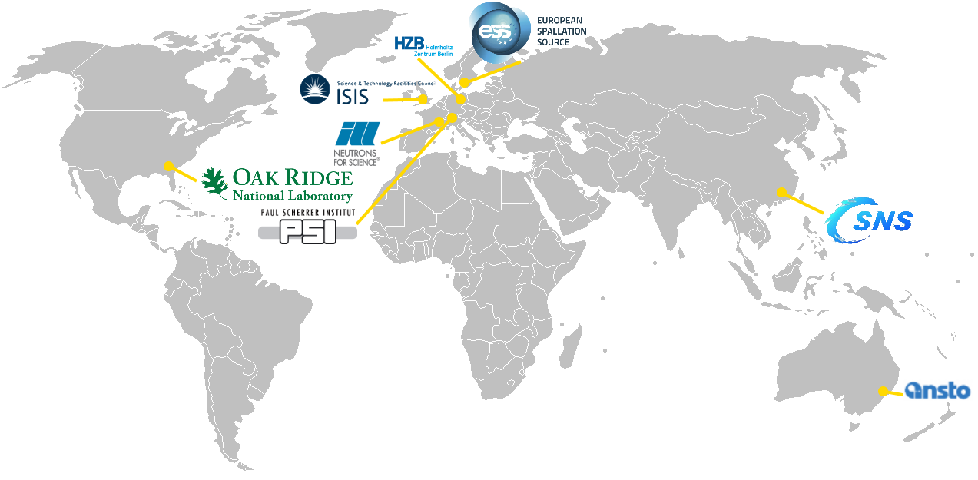
Facilities that use Mantid

Slide 14
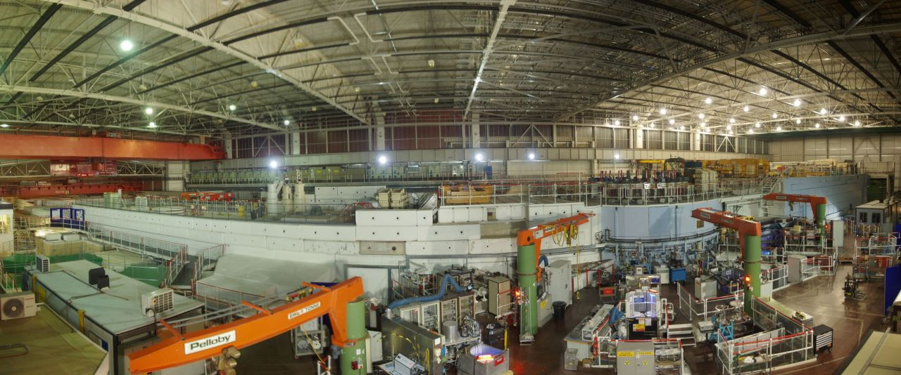
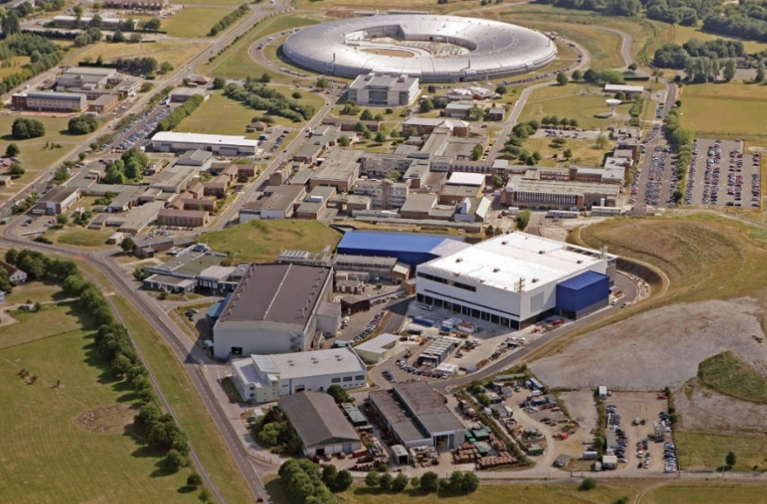
UK - ISIS
Spallation Source
2 Target Stations
35 Neutron and Muon Instruments
Birthplace of the Mantid Project

Slide 15
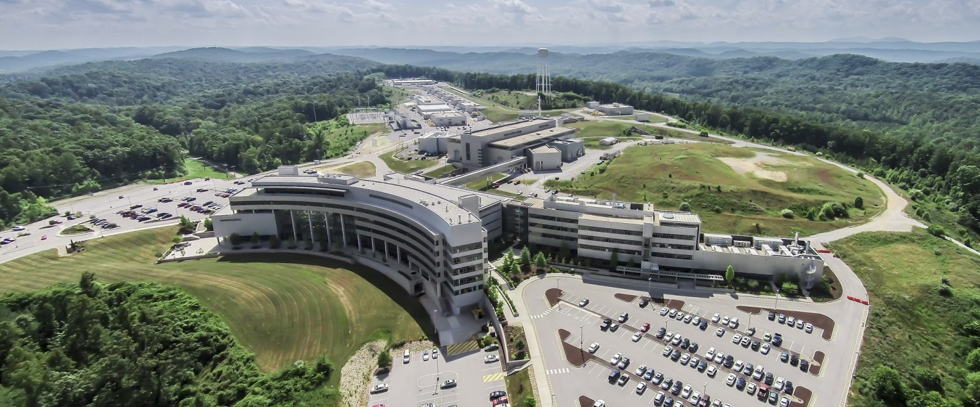
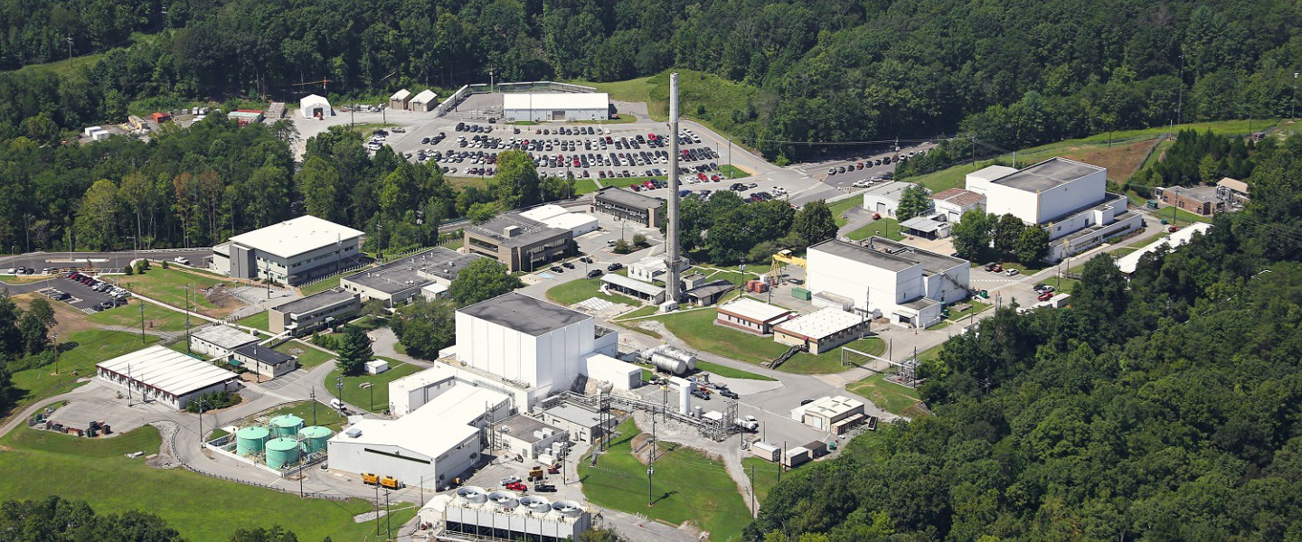
US – SNS & HFIR
SNS
Spallation Source
1 Target Station (so far)
20 Neutron Instruments
HFIR
Fission Reactor
13 Neutron Instruments

Slide 16
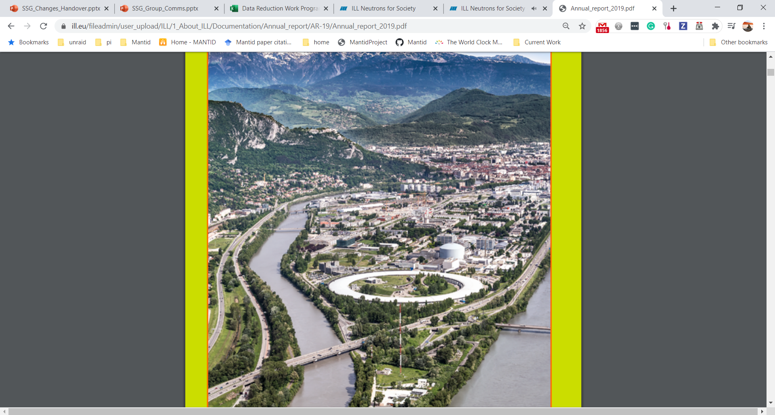
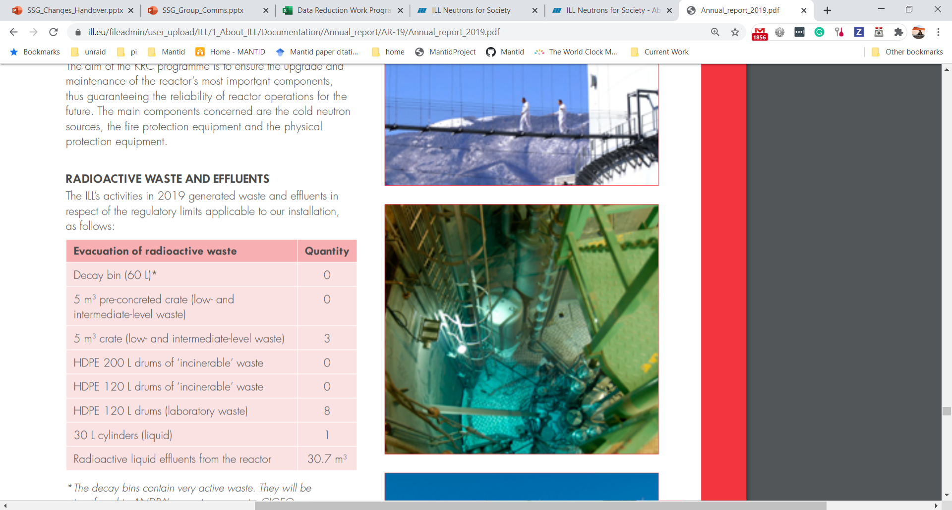
France - ILL
Fission Reactor
37 Neutron Instruments

Slide 17
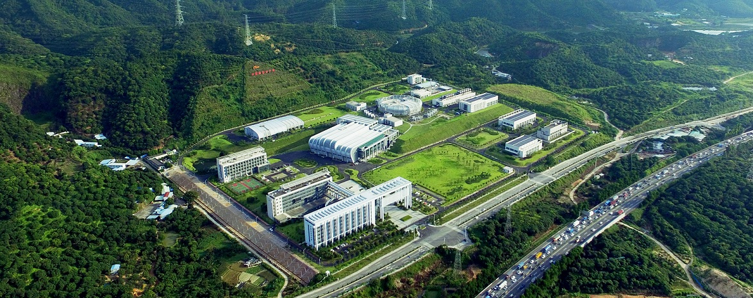
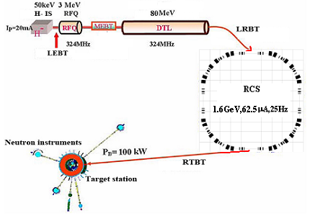
China - CSNS
Spallation Source
Recently opened to users
3 Instruments
Rapid instrument expansion programme

Slide 18
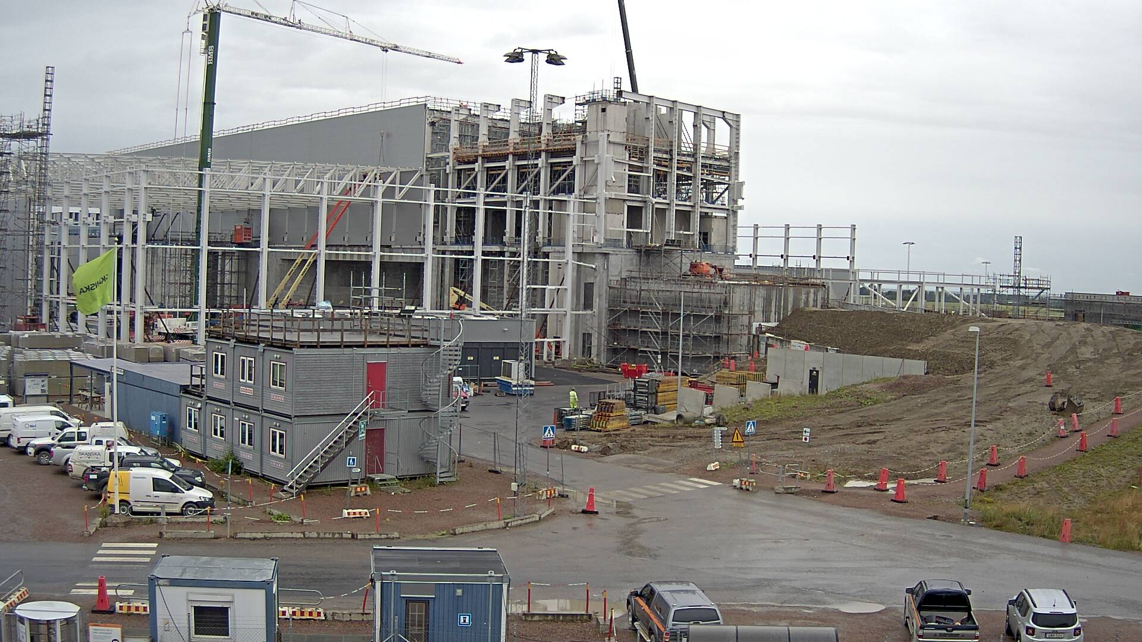

Sweden - ESS
Spallation Source
Under construction
First users 2025?

Slide 19

Scientific Data Flow
Raw Data
Time & Detector Coords
Useful for Diagnostics & Fault finding
Full of measurement artefacts

Slide 20

Raw Data
Merlin
256 x 272 = 70K Pixels
x 500 = 35M Pixels
256 Detectors
500 Time Channels
272 Tubes

Slide 21
Raw Event Data
Size Dependent on:
Time (ms) | Detector | Time Of Flight (ns)
2020-07-10 15:06:22.050 | 252 | 500,000
2020-07-10 15:06:22.050 | 8795 | 134,000
2020-07-10 15:06:22.050 | 3 | 908,000
2020-07-10 15:06:22.150 | 4568 | 589,000
2020-07-10 15:06:22.150 | 2346 | 546,000
2020-07-10 15:06:22.150 | 97854 | 376,000
2020-07-10 15:06:22.450 | 23378 | 99,000
Neutron Rate
Run Duration

Slide 22

Scientific Data Flow
Raw Data
Time & Detector Coords
Reduced Data
Measurement artefacts corrected
Scientific Units
Useful for Diagnostics & Fault finding
Full of measurement artefacts
Size: compressed or expanded

Slide 23

Multi Dimensional Visualization

Slide 24


Scientific Data Flow
Raw Data
Time & Detector Coords
Reduced Data
Measurement artefacts corrected
Scientific Units
Data Analysis
Comparison with physical models
Extraction of understanding
Impact
Useful for Diagnostics & Fault finding
Full of measurement artefacts
Size: compressed or expanded
New materials
Process changes
Commercialization
Scientific Publication

Slide 25


Scientific Data Flow
Raw Data
Time & Detector Coords
Reduced Data
Measurement artefacts corrected
Scientific Units
Data Analysis
Comparison with physical models
Extraction of understanding
Impact
Useful for Diagnostics & Fault finding
Full of measurement artefacts
Size: compressed or expanded
Commercialization
Scientific Publication
Process changes
New materials

Slide 26

Scientific Data Flow
Raw Data
Time & Detector Coords
Reduced Data
Measurement artefacts corrected
Scientific Units
Data Analysis
Comparison with physical models
Extraction of understanding
Impact
Useful for Diagnostics & Fault finding
Full of measurement artefacts
Size: compressed or expanded
Commercialization
Scientific Publication
Process changes
New materials
Visualization
Algorithms
Model Fitting & Optimisation
Live Data

Slide 27
Some Users
Most Users
Flexible user interface
Python Scripting
Technique specific interfaces
Point and click interface
Training & Examples
Super Users
Plug ins
Python Algorithms
Custom User Interfaces
Detailed help
Data History
Powerful visualisations
Simple Graphing
Matching the users experience

Slide 28

ISIS Virtual Tour
https://www.isis.stfc.ac.uk/Pages/ISIS-360-Tour.aspx

Slide 29
Thank you
Facebook: Science and Technology Facilities Council
Twitter:@STFC_matters
YouTube: Science and Technology Facilities Council

